Slide 1
PACMAN using episodic semi-gradient n-step Sarsa algorithm
RL Project By: Tarush Kumar Goyal(110) Charvi Jain(113)

Slide 2
Problem Statement
Leverage Reinforcement Learning to empower an AI agent to autonomously excel in Pac-Man, showcasing its capability to adeptly navigate dynamic challenges, make strategic real-time decisions, and continuously enhance its gameplay strategy.

Slide 3
Objective
Develop an advanced Reinforcement Learning (RL) model to master the classic game of Pac-Man, demonstrating the AI's ability to make complex decisions in real-time, navigate changing environments, learn from interactions, and improve strategies for high-performance gameplay.
Roadblocks we faced:
Adapting to the game's unpredictable elements and evolving difficulties.
Balancing risk and reward for optimal pathfinding and ghost evasion.
Scaling learning algorithms to handle diverse scenarios and strategies.
Achievements
Success in this project could showcase the potential of RL in various applications requiring real-time decision-making and strategy optimization in dynamic conditions.

Slide 4
Literature Survey
Sr. No | Paper | Algorithm used | Performance Metrics | Inference
1 | Training Agent to Play Pac-Man under Authentic Environment Based on Image Recognition | Optimized agent behaviour using DQN, A*, and DFS algorithm | Optimized agent behavior for higher scores using DQN algorithm.Inspired by A* and DFS graph traversal. | Train a Pac-Man agent using Deep Q-learning and image recognition in a real game environment to optimize its behavior for higher scores.
2 | Pacman Game Reinforcement Learning Using Artificial Neural-network and Genetic Algorithm | Genetic algorithm Artificial neural network | Reinforcement of Pacman in an environment using an AI simulator. | The paper implements reinforcement learning for Pac-Man using a genetic algorithm and artificial neural network to enhance the AI's learning process efficiently.

Slide 5
Sr. No | Paper | Algorithm used | Performance Metrics | Inference
3 | Learning Options From Demonstrations: A Pac-Man Case Study | Extracts information from expert demos. Uses inferred goals to bias decisions while learning. | Improved final performance compared to state-of-the-art approach. Statistically significant evidence of performance improvement in Pac-Man game. | Paper introduces a novel algorithm that utilizes expert demonstrations to improve Pac-Man's performance through reinforcement learning,
4 | Machine learning applied to Pac-Man | Machine learning techniques. Develops a learning model for Pac-Man ghosts | Model performance evaluated using accuracy, speed, and efficiency metrics. | Develops a learning model for Pac-Man ghosts. Adjusts difficulty based on Pac-Man level, omitting original game challenges.
5 | Training Pac-Man bots using reinforcement learning and case-based reasoning. | Case-based reasoning, Reinforcement learning with Q-learning algorithm | High scores or survival time achieved by trained bots. Balancing between exploitation and exploration in reinforcement learning. | The paper combines case-based reasoning and reinforcement learning to train Pac-Man bots, achieving high scores or survival but facing challenges in combining both goals effectively.

Slide 6
Learning Algorithm
The episodic semi-gradient n-step Sarsa algorithm is a variation of the classic Sarsa algorithm, designed for reinforcement learning tasks with function approximation. It extends the original Sarsa algorithm by incorporating semi-gradient updates and bootstrapping over multiple steps to improve learning efficiency and handle delayed rewards.
Instead of updating the weights based on the complete return (sum of discounted rewards), as in traditional Sarsa, the algorithm employs a semi-gradient approach. It updates the weights towards a target value that is a combination of immediate rewards and estimated future rewards, calculated over n steps.This update rule ensures that the weights are adjusted in the direction that minimizes the error between the estimated and target values, facilitating learning while avoiding instability.

Slide 7
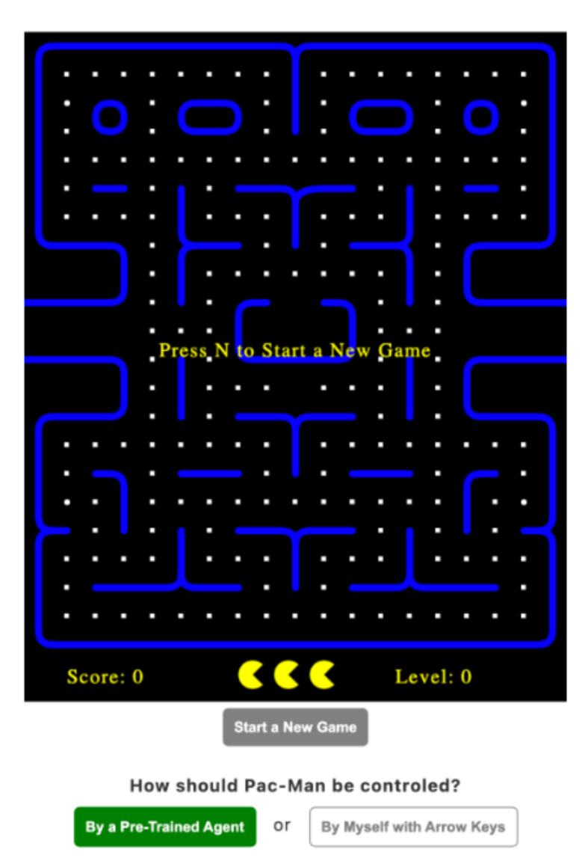
Output
For Source Code, please check : https://github.com/charvijain12/PacMan

Slide 8
Conclusion
The application of the episodic semi-gradient n-step Sarsa algorithm in the Pacman reinforcement learning project showcases the power and effectiveness of modern machine learning techniques in solving complex real-world problems. By leveraging advanced algorithms, such as Sarsa with function approximation and gradient-based updates, coupled with sophisticated state encoding and reward shaping strategies, the Pacman agent demonstrates remarkable learning capabilities in navigating a challenging maze environment.

